Slide 1


Kanka Dutta
6/02/2025

Slide 2

Outline
Executive Summary
Introduction
Methodology
Results
Conclusion
Appendix

Slide 3
Executive Summary
Data Collection- Data is collected from web scrapping(wikipedea) and SPACEX REST API.
Data wrangling
Explorative Data Analysis-The data is analyzed using SQL and pandas.
Data visualization- Different relationship of factors are viewed in form of line charts bar charts and scatterplots
Predictive analysis-Different models are built and their accuracy are compared to choose the best performing model.
Results-
Launch success has improved over time.
All models performed quite similarly but decision tree is the model of choice
KSC-LC39A has higher success rate.
Orbit SSO,GEO,HEO and ES-L1 has 100% success rate.

Slide 4
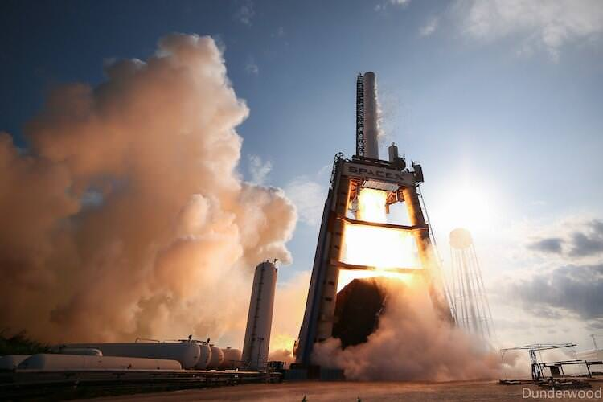
Introduction
We will predict if the Falcon 9 first stage will land successfully. SpaceX advertises Falcon 9 rocket launches on its website with a cost of 62 million dollars; other providers cost upward of 165 million dollars each, much of the savings is because SpaceX can reuse the first stage. Therefore, if we can determine if the first stage will land, we can determine the cost of a launch. This information can be used if an alternate company wants to bid against SpaceX for a rocket launch.
In this project we are going to look into all the different components that might help us understanding and effectively predict the success rate of the launch of the falcon 9 model.
This Photo by Unknown Author is licensed under CC BY

Slide 5

Section 1

Slide 6
Methodology
Executive Summary
Data collection methodology:
Data is collected from SpaceX API and from its Wikipedia page.
Perform data wrangling.
Perform exploratory data analysis (EDA) using visualization and SQL
Perform interactive visual analytics using Folium and Plotly Dash
Perform predictive analysis using classification models
All models performed quite similarly but decision tree is the model of choice.

Slide 7
Data Collection
• Request data from SpaceX API (rocket launch data)
• Decode response using .json() and convert to a dataframe using .json_normalize()
• Request information about the launches from SpaceX API using custom functions
• Create dictionary from the data
• Create dataframe from the dictionary
• Filter dataframe to contain only Falcon 9 launches
• Replace missing values of Payload Mass with calculated .mean()
• Export data to csv file

Slide 8
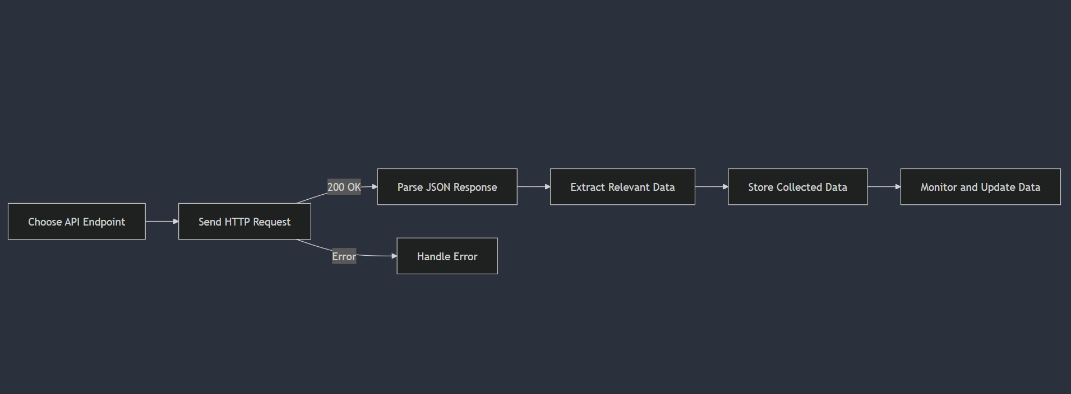
Data Collection – SpaceX API
• Request data from SpaceX API (rocket launch data)
• Decode response using .json() and convert to a dataframe using .json_normalize()
• Request information about the launches from SpaceX API using custom functions
• Create dictionary from the data
• Create dataframe from the dictionary
• Filter dataframe to contain only Falcon 9 launches
• Replace missing values of Payload Mass with calculated .mean()
• Export data to csv file.
Link-https://github.com/konkodutta/capstone-projects/blob/496020ee23c01db3a32168e89641de4f1cecd45d/jupyter-labs-spacex-data-collection-api.ipynb
Place your flowchart of SpaceX API calls here

Slide 9
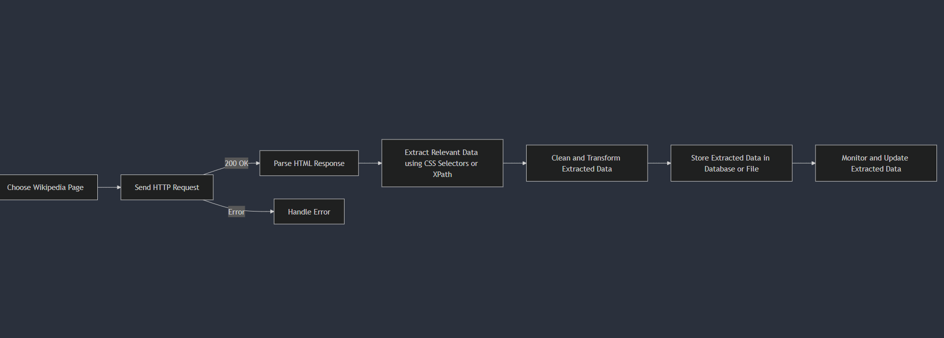
Data Collection - Scraping
Request data (Falcon 9 launch data) from Wikipedia
Create BeautifulSoup object from HTML response
Extract column names from HTML table header
Collect data from parsing HTML tables.
Create dictionary from the data
Create dataframe from the dictionary
Export data to csv file.
Link-https://github.com/konkodutta/capstone-projects/blob/496020ee23c01db3a32168e89641de4f1cecd45d/jupyter-labs-webscraping.ipynb
Place your flowchart of web scraping here

Slide 10
Data Wrangling
Notebook link-https://github.com/konkodutta/capstone-projects/blob/496020ee23c01db3a32168e89641de4f1cecd45d/labs-jupyter-spacex-Data%20wrangling.ipynb

Slide 11
EDA with Data Visualization
Charts
• Flight Number vs. Payload
• Flight Number vs. Launch Site
• Payload Mass (kg) vs. Launch Site
• Payload Mass (kg) vs. Orbit type EDA with Visualization
Analysis
• View relationship by using scatter plots. The variables could be useful for machine learning if a relationship exists.
• Show comparisons among discrete categories with bar charts. Bar charts show the relationships among the categories and a measured value.
Link-https://github.com/konkodutta/capstone-projects/blob/496020ee23c01db3a32168e89641de4f1cecd45d/jupyter-labs-eda-dataviz-v2.ipynb

Slide 12
EDA with SQL
• Names of unique launch sites
• 5 records where launch site begins with ‘CCA’
• Total payload mass carried by boosters launched by NASA (CRS)
• Average payload mass carried by booster version F9 v1.1.
• Date of first successful landing on ground pad
• Names of boosters which had success landing on drone ship and have payload mass greater than 4,000 but less than 6,000 • Total number of successful and failed missions
• Names of booster versions which have carried the max payload
• Failed landing outcomes on drone ship, their booster version and launch site for the months in the year 2015
• Count of landing outcomes between 2010-06-04 and 2017-03-20 (desc)
Link-https://github.com/konkodutta/capstone-projects/blob/496020ee23c01db3a32168e89641de4f1cecd45d/jupyter-labs-eda-sql-coursera_sqllite.ipynb

Slide 13
Build an Interactive Map with Folium
• Added blue circle at NASA Johnson Space Center's coordinate with a popup label showing its name using its latitude and longitude coordinates
• Added red circles at all launch sites coordinates with a popup label showing its name using its name using its latitude and longitude coordinates Map with Folium Colored Markers of Launch Outcomes
• Added colored markers of successful (green) and unsuccessful (red) launches at each launch site to show which launch sites have high success rates Distances Between a Launch Site to Proximities
• Added colored lines to show distance between launch site CCAFS SLC40 and its proximity to the nearest coastline, railway, highway, and city.

Slide 14
Build a Dashboard with Plotly Dash
Notebook Link-https://github.com/konkodutta/capstone-projects/blob/496020ee23c01db3a32168e89641de4f1cecd45d/spacex_dash_app.py

Slide 15
Predictive Analysis (Classification)
• Create NumPy array from the Class column
• Standardize the data with StandardScaler. Fit and transform the data.
• Split the data using train_test_split
• Create a GridSearchCV object with cv=10 for parameter optimization
• Apply GridSearchCV on different algorithms: logistic regression (LogisticRegression()), support vector machine (SVC()), decision tree (DecisionTreeClassifier()), K-Nearest Neighbor (KNeighborsClassifier())
• Calculate accuracy on the test data using .score() for all models
• Assess the confusion matrix for all models
• Identify the best model using Accuracy.
Link-https://github.com/konkodutta/capstone-projects/blob/496020ee23c01db3a32168e89641de4f1cecd45d/SpaceX-Machine-Learning-Prediction-Part-5-v1.ipynb

Slide 16
Results
Launch success has improved over time.
All models performed quite similarly but decision tree is the model of choice
KSC-LC39A has higher success rate.
Orbit SSO,GEO,HEO and ES-L1 has 100% success rate.

Slide 17

Section 2

Slide 18
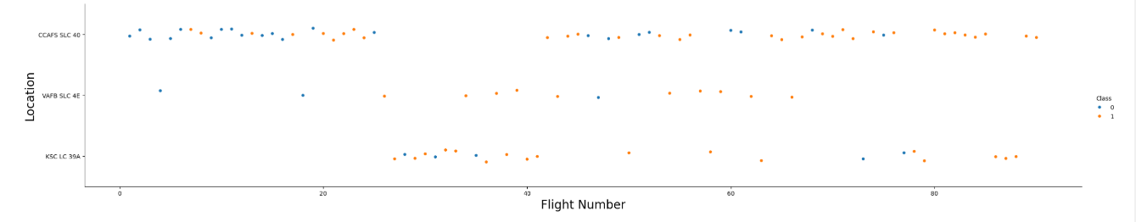
Flight Number vs. Launch Site
We can infer that new launches have a higher success rate
VAFB SLC 4E and KSC LC 39A have higher success rates

Slide 19
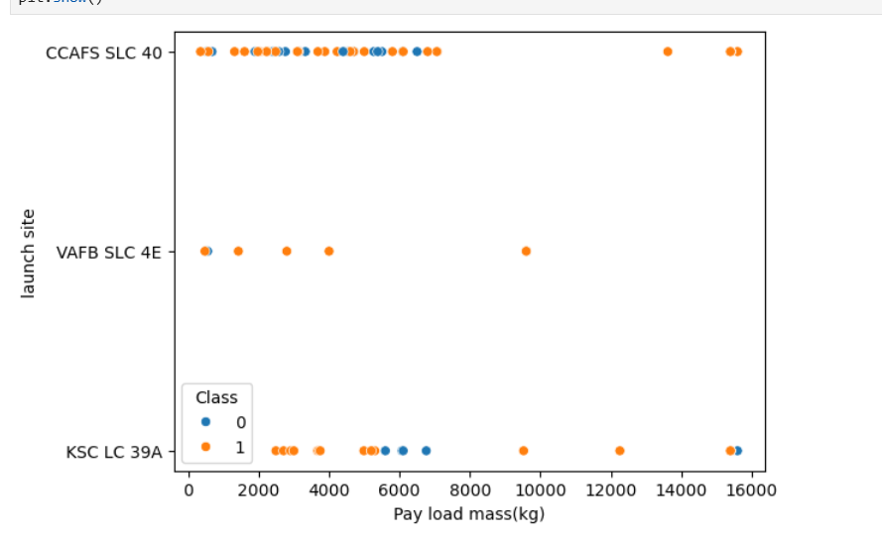
Payload vs. Launch Site
Now if you observe Payload Mass Vs. Launch Site scatter point chart you will find for the VAFB-SLC launchsite there are no rockets launched for heavy payload mass(greater than 10000).

Slide 20
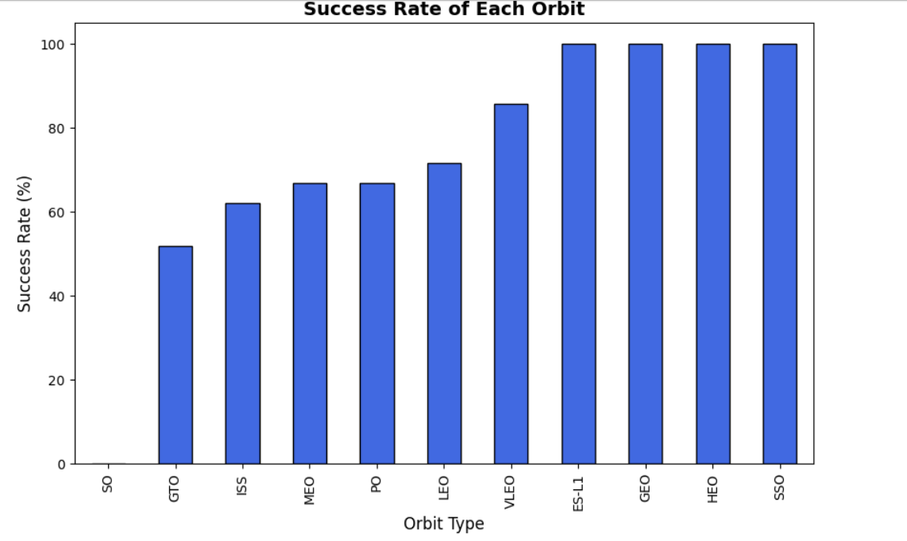
Success Rate vs. Orbit Type
Orbits like ES-L1,GEO,HEO,SSO has 100% success rate.

Slide 21
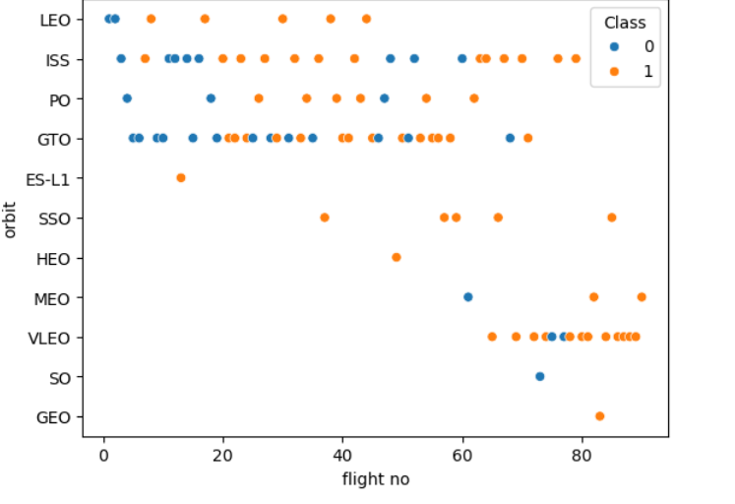
Flight Number vs. Orbit Type
You can observe that in the LEO orbit, success seems to be related to the number of flights. Conversely, in the GTO orbit, there appears to be no relationship between flight number and success.

Slide 22
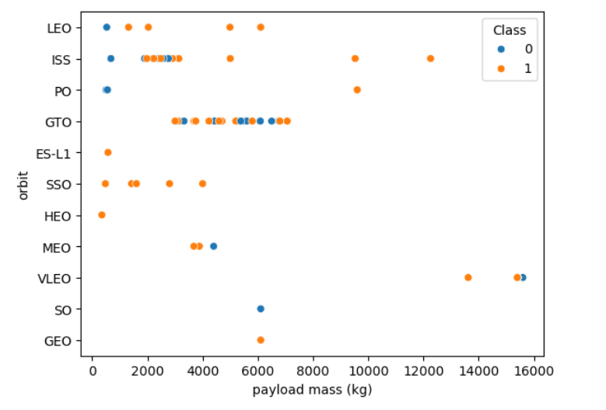
Payload vs. Orbit Type
With heavy payloads the successful landing or positive landing rate are more for Polar,LEO and ISS.
However, for GTO, it's difficult to distinguish between successful and unsuccessful landings as both outcomes are present.

Slide 23
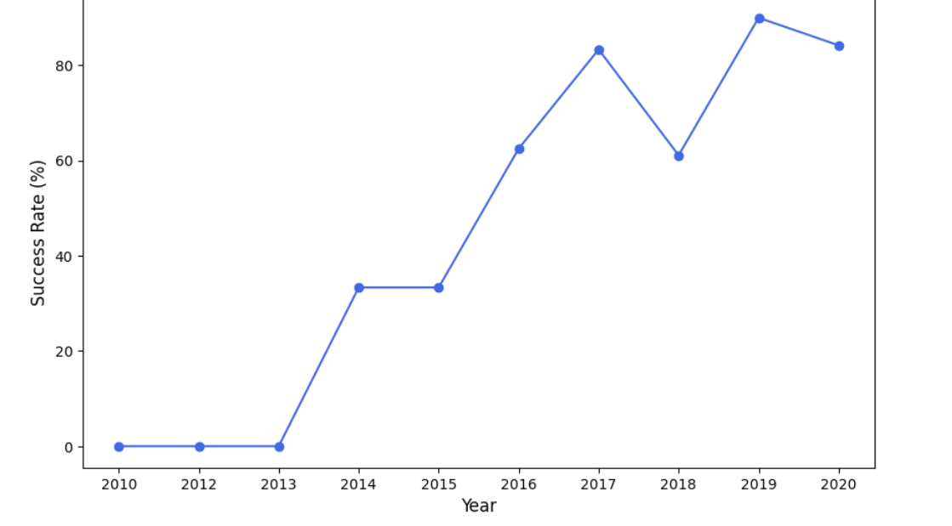
Launch Success Yearly Trend
You can observe that the sucess rate since 2013 kept increasing till 2020

Slide 24
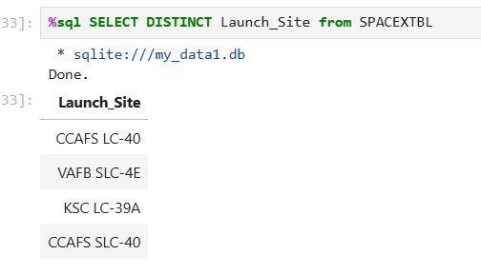
All Launch Site Names
Query=

Slide 25
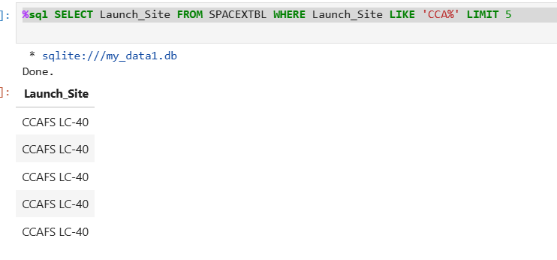
Launch Site Names Begin with 'CCA'
Query=

Slide 26
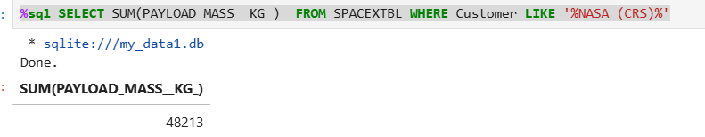
Total Payload Mass
Query=

Slide 27
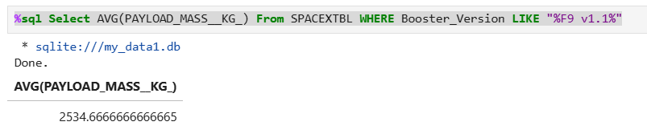
Average Payload Mass by F9 v1.1
Query:

Slide 28
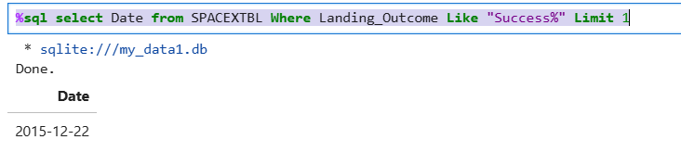
First Successful Ground Landing Date
Query:

Slide 29
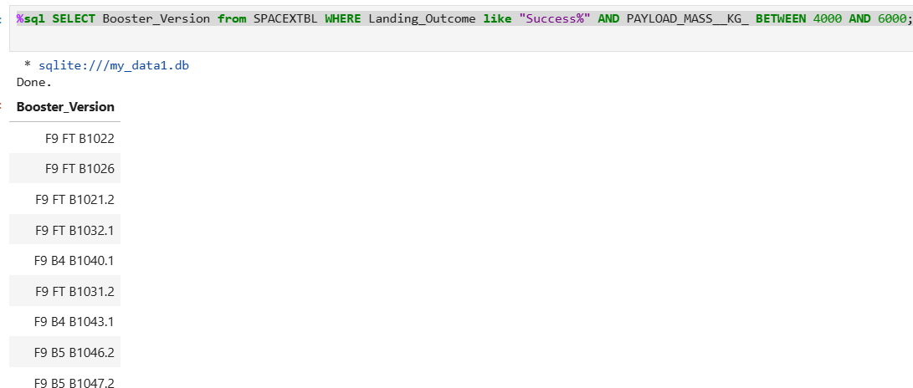
Successful Drone Ship Landing with Payload between 4000 and 6000
Query:

Slide 30
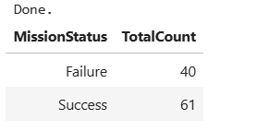
Total Number of Successful and Failure Mission Outcomes
Query:

Slide 31
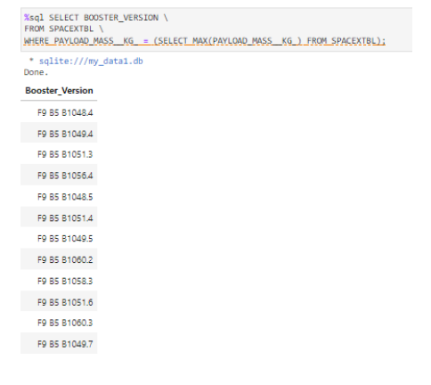
Boosters Carried Maximum Payload
Query:

Slide 32
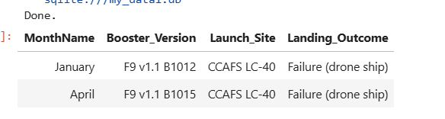
2015 Launch Records
Query:

Slide 33
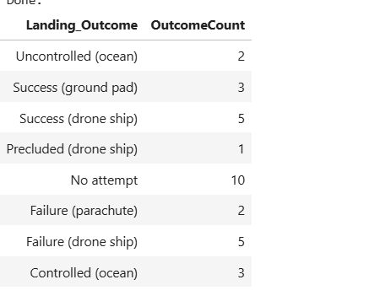
Rank Landing Outcomes Between 2010-06-04 and 2017-03-20
Query:

Slide 34

Section 3

Slide 35
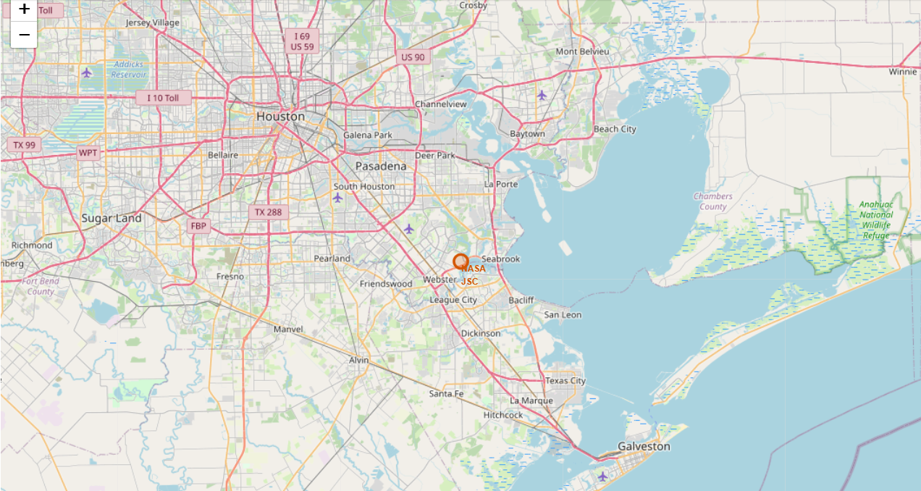
<Folium Map Screenshot 1>

Slide 36
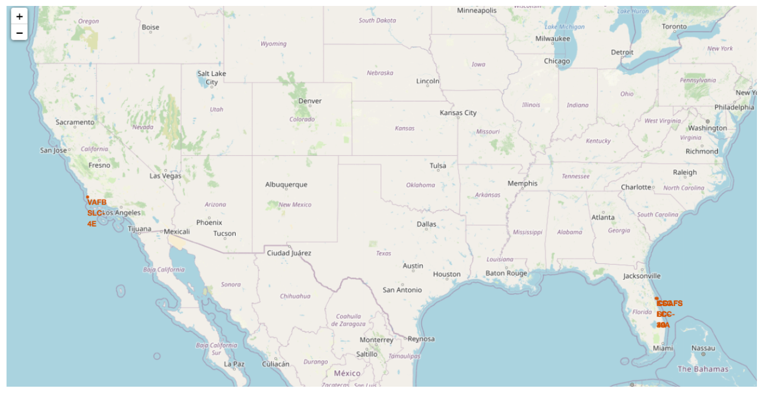
<Folium Map Screenshot 2>
Replace <Folium map screenshot 2> title with an appropriate title
Explore the folium map and make a proper screenshot to show the color-labeled launch outcomes on the map
Explain the important elements and findings on the screenshot

Slide 37
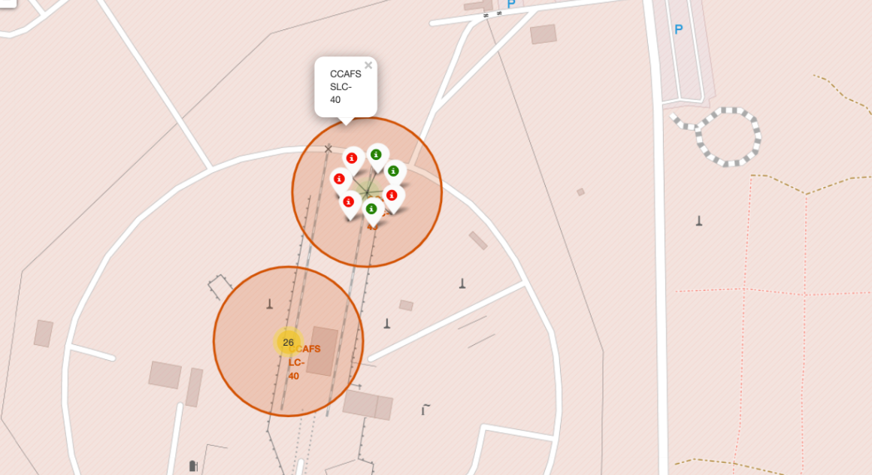
<Folium Map Screenshot 3>
Replace <Folium map screenshot 3> title with an appropriate title
Explore the generated folium map and show the screenshot of a selected launch site to its proximities such as railway, highway, coastline, with distance calculated and displayed
Explain the important elements and findings on the screenshot

Slide 38

Section 4

Slide 39
<Dashboard Screenshot 1>
Replace <Dashboard screenshot 1> title with an appropriate title
Show the screenshot of launch success count for all sites, in a piechart
Explain the important elements and findings on the screenshot

Slide 40
<Dashboard Screenshot 2>
Replace <Dashboard screenshot 2> title with an appropriate title
Show the screenshot of the piechart for the launch site with highest launch success ratio
Explain the important elements and findings on the screenshot

Slide 41
<Dashboard Screenshot 3>
Replace <Dashboard screenshot 3> title with an appropriate title
Show screenshots of Payload vs. Launch Outcome scatter plot for all sites, with different payload selected in the range slider
Explain the important elements and findings on the screenshot, such as which payload range or booster version have the largest success rate, etc.

Slide 42

Section 5

Slide 43
Classification Accuracy
Visualize the built model accuracy for all built classification models, in a bar chart
Find which model has the highest classification accuracy

Slide 44

Confusion Matrix
All of the models performed very similarly but the decision tree model is picked as the model of choice.
A confusion matrix summarizes the performance of a classification algorithm.
All the confusion matrices were identical.
Here I the confusion matrix of the decision tree model:
3 false positives
3 true negatives
12 true postivies
0 false negatives

Slide 45
Conclusions
All of the classification models performed very similarly except the KNN classification model.
All of the model had an accuracy of 83%
While KNN had an accuracy of 61%
The model of choice id decision tree model.
Some of the conclusions we can derive from the above analysis is
Launch Success: Increases over time
KSC LC-39A: Has the highest success rate among launch sites. Has a 100% success rate for launches less than 5,500 kg
Orbits: ES-L1, GEO, HEO, and SSO have a 100% success rate.
Payload Mass: Across all launch sites, the higher the payload mass (kg), the higher the success rate

Slide 46


